Slide 1

ECU Optimization Tool
User Guide

Slide 2
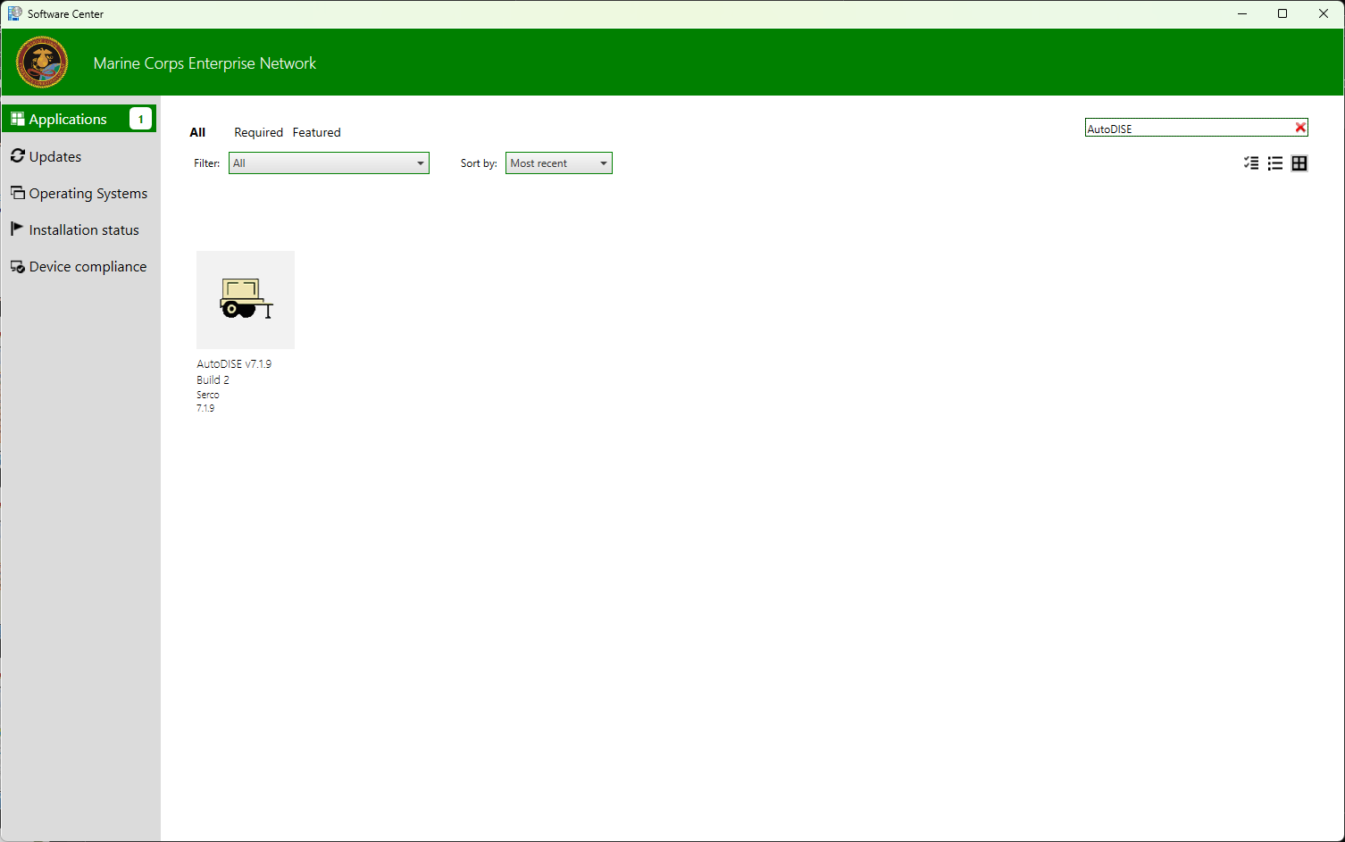
Step 0: Install AutoDISE
If you haven’t already, download AutoDISE from the MCEN Software Center.

Slide 3
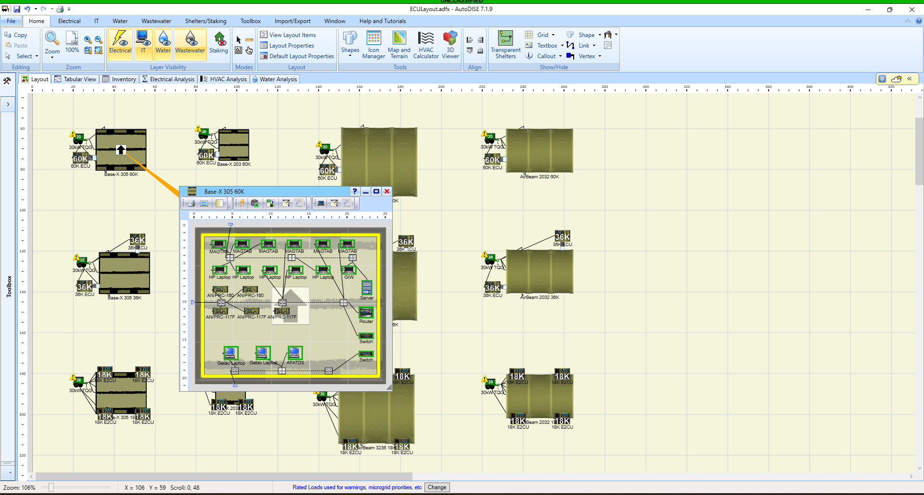
Step 1: Build Your Layout in AutoDISE
Build as many shelter configurations as you wish.
Ensure all consumers and ECUs are properly connected.
Name your shelters something distinct that you can remember. The tool uses these names.
The ECU you use here does not matter. The tool will test all different combinations of ECUs.

Slide 4
Step 2: Set Your Environment
Click here to set up the environment
The more realistic you make your environment and shelters, the better the analysis will be.
Optional: While AutoDISE comes preloaded with climate data, it can be inaccurate in some cases. Average climate data can be accessed here if you wish to manually input real data.

Slide 5
Step 3: Select Shelters To Export
1. Go here
2. Select all shelters to export
Select all the shelters you want to analyze on the left using the check boxes. Do not select anything but shelters.

Slide 6
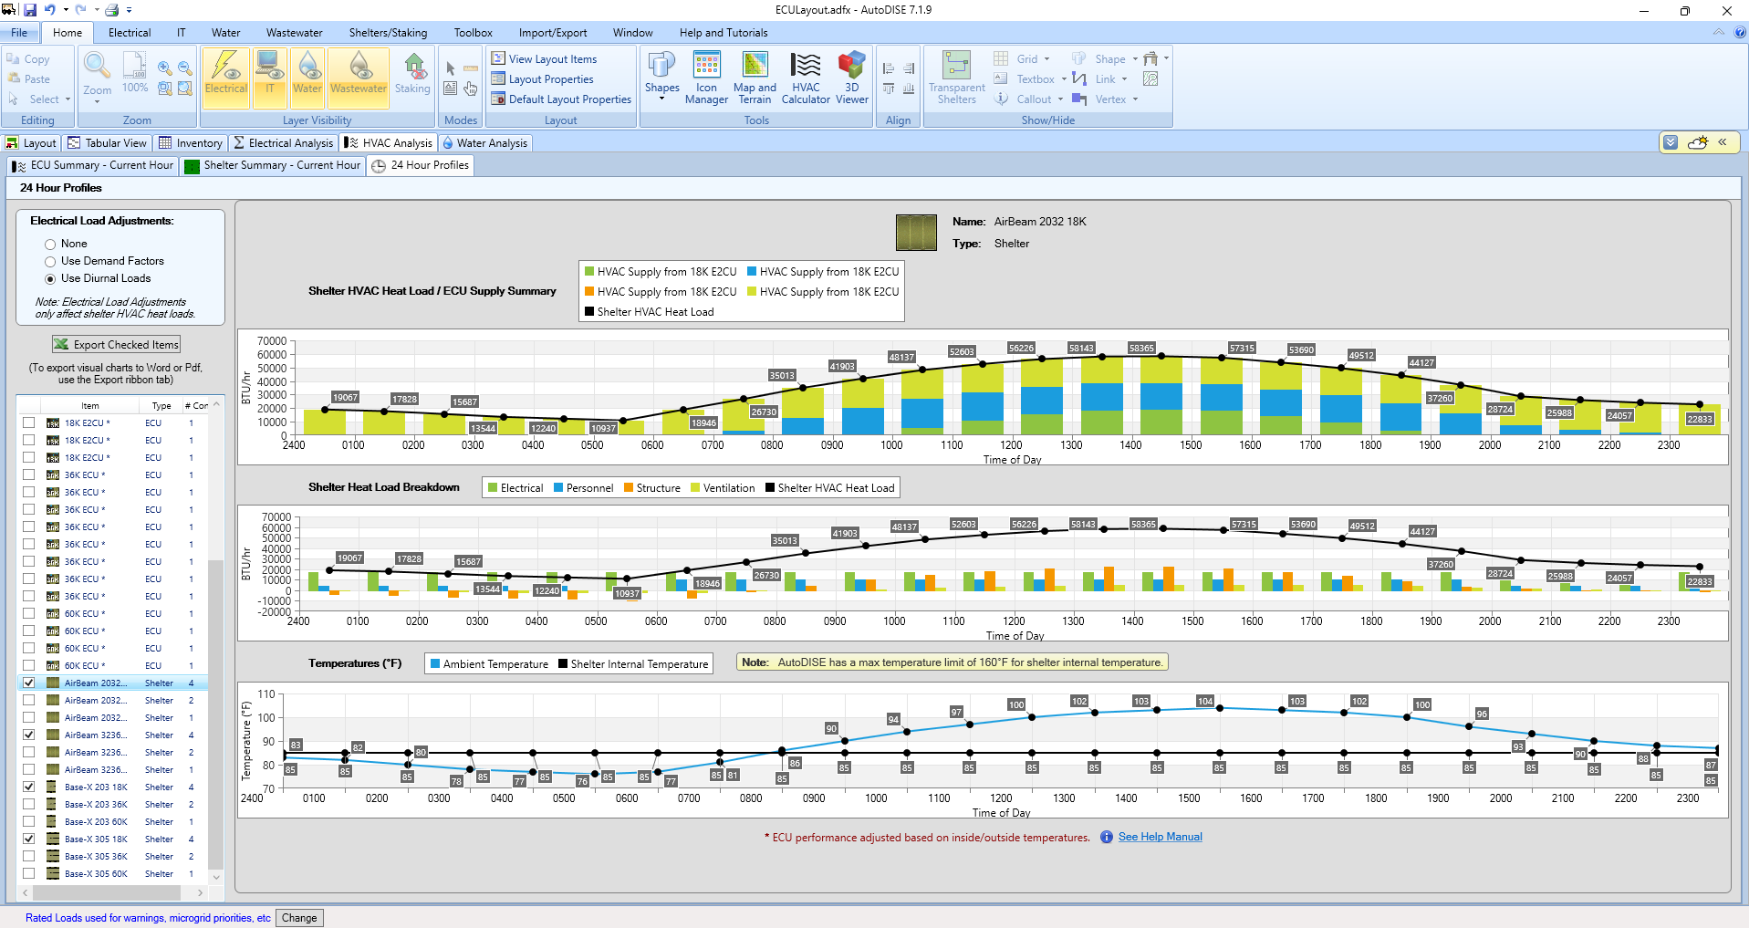
Step 4a: Download Data
Click this to download
Export the data to anywhere on your computer. It will output an XLS file.

Slide 7
Step 4b (Optional): Convert To CSV File
Click this once you open the file in browser
This step is optional because the tool can accept either XLS or CSV files.
MCEN computers can’t open XLS files using the desktop app. If you wish to open the file, you can view and convert it to a CSV file using Excel Online (link).

Slide 8
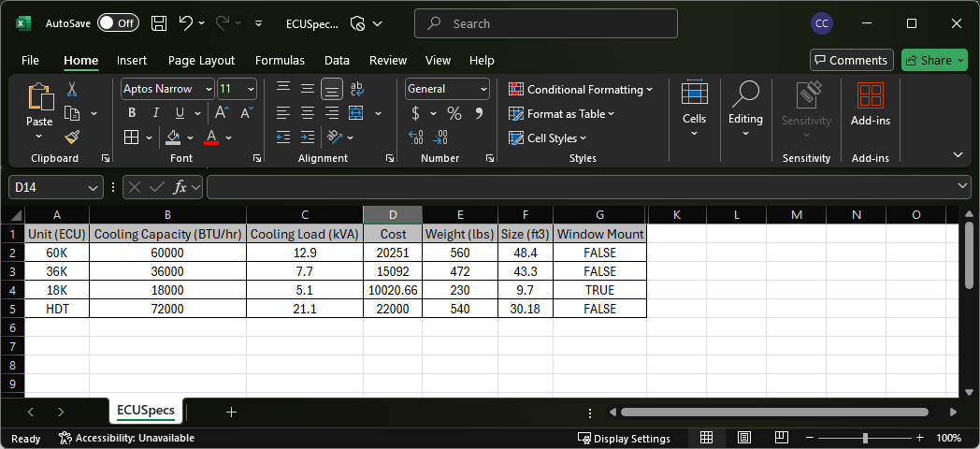
Step 5: Input ECU Data
All column header names must remain unchanged.
If you haven’t already, input all ECU data into the ECU specifications spreadsheet. This data will come from the Technical Manual or manufacturer.

Slide 9
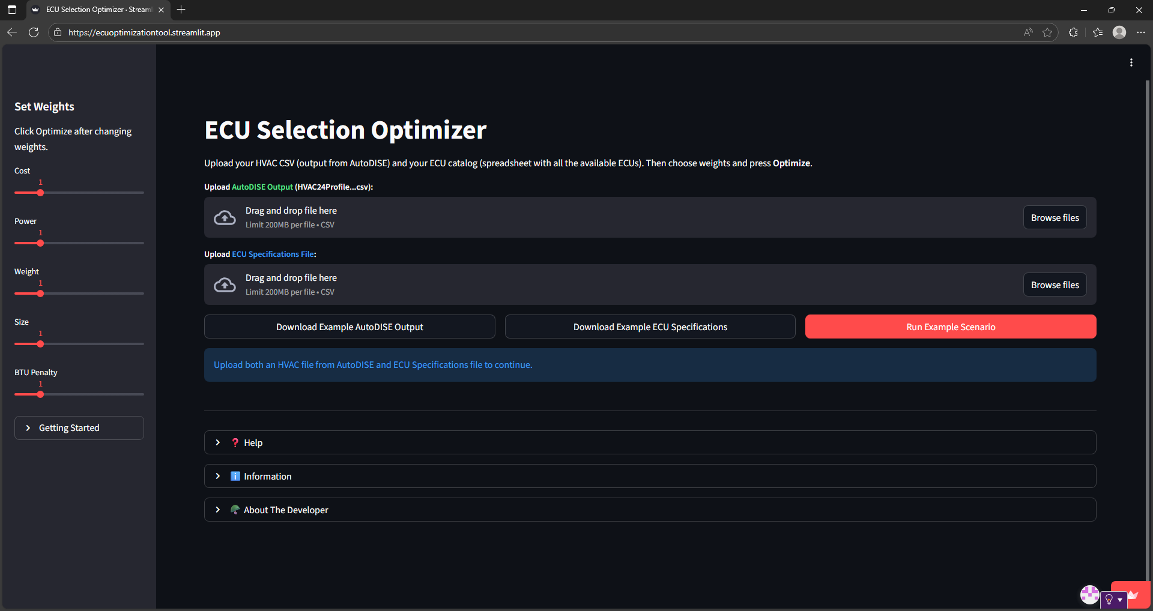
Step 6: Open The Tool
Type or paste link
This will work in any browser.
Open your browser and go to the link:
https://ecuoptimizationtool.streamlit.app/

Slide 10
Step 7: Upload Files
Drag and drop each file into its respective place or click “Browse Files”
All column header names must remain unchanged.
Upload your AutoDISE output (CSV, XLS, or XLSX) and
ECU specifications file (CSV or XLSX)

Slide 11
Step 8: Window Compatibility Check
Toggle window-unit compatibility on/off
All column header names must remain unchanged.
Optional: Change shelter name if needed.
If any of the shelters in your data can’t accept a window-mounted ECU, toggle the check off.

Slide 12
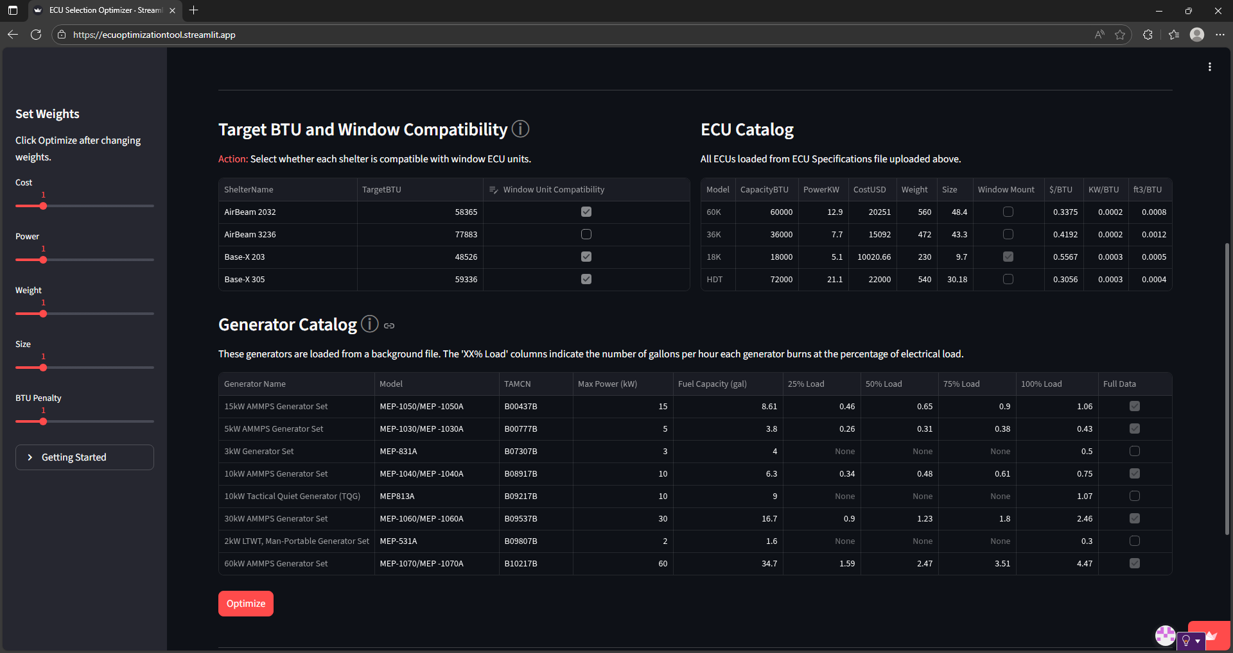
Step 9: Select Weights
Set weights to prioritize the optimization of different parameters.
All column header names must remain unchanged.
These weights are used to score the mixes of ECUs that the algorithm tries. The solution for each shelter becomes the mixture that scores the best (lowest) for each shelter.

Slide 13
Step 10: Solve
Select “Optimize”
All column header names must remain unchanged.
If the solution is successful, the solution metrics and multiple graphs will be shown.

Slide 14
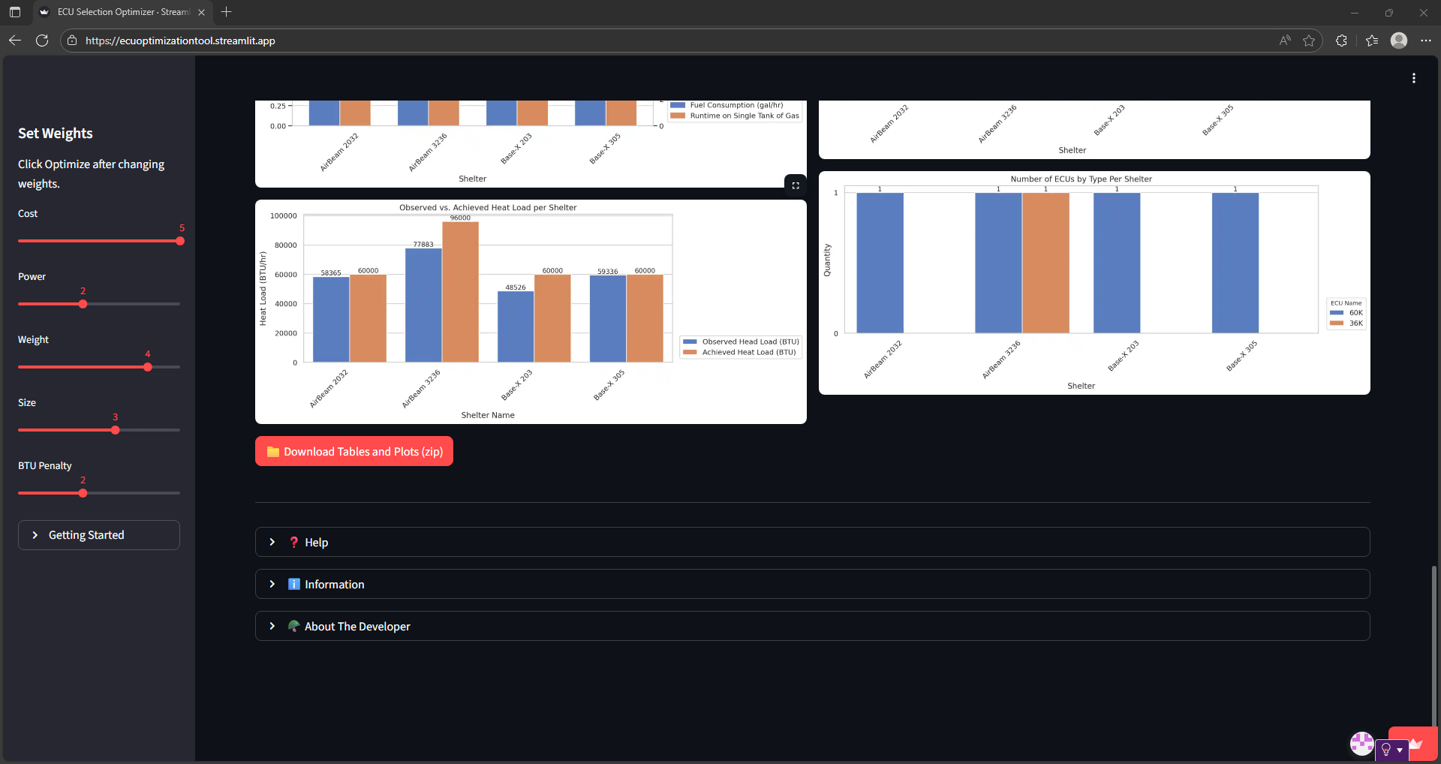
Optional Additional Steps
Change weights and re-run as needed. Must click “Optimize” again after changing any of the weights.
All column header names must remain unchanged.
Click to view any of the graphs in full screen
Download all outputs to your computer in a single zip folder
View additional help and information
Feel free to run the optimization as many times as you wish.

